Slide 1

A convolutional auto-encoder for reduced order models on unstructured meshes
Author：Jiaye Mao
Supervisors: Christopher Pain, Claire Heaney
Notes:
Hi, My name is Jiaye Mao
A process of compression
Reduced Order Models (ROMs) can reduce the model’s
space dimension or degrees of freedom.
increase substantially computational efficiency while maintaining reasonable accuracy.
The traditional compress method for ROM is POD is a method of compressing the snapshots matrix into a small number of basis functions which keep the principle behaviour of the system.

Slide 2
Background & Motivation
Simulation for fluid flow problems governed by N-S equation is slow.
Reduced Order Modelling(ROM) can speed up the simulation
Faster speed could enable real-time decision making
Notes:
The traditional way of ROM
ROM is better
Reduced Order Models (ROMs) can reduce the model’s
space dimension or degrees of freedom.
increase substantially computational efficiency while maintaining reasonable accuracy.
Using machine learning method

Slide 3
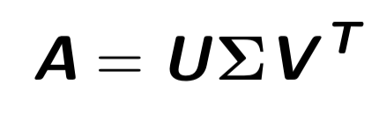
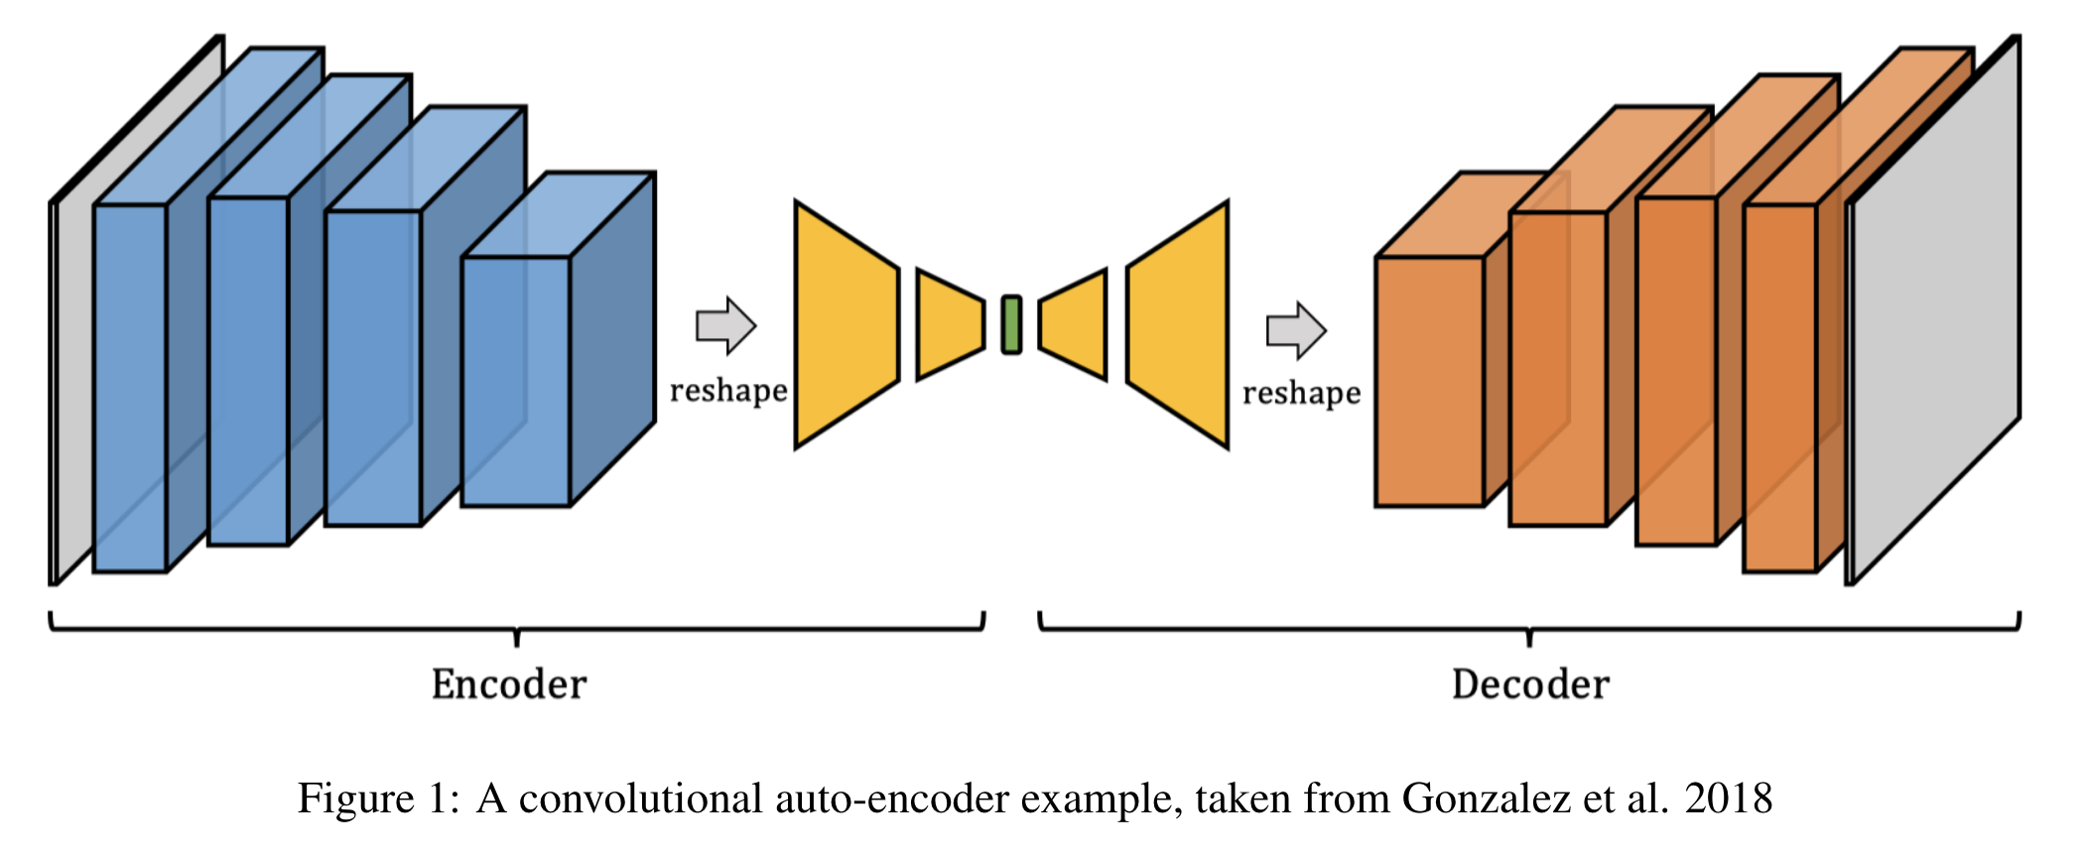
Methods of Compression
Singular Value Decomposition
Convolutional Auto-encoder
Notes:
The traditional compress method for ROM is POD is a method of compressing the snapshots matrix into a small number of basis functions which keep the principle behaviour of the system.
The main limitation of POD is its linear nature since many data sets include essential nonlinear structures that are invisible to POD
Auto-encoder is capable of finding more hidden correlation within the data than traditional methods\citep{wang2018model}.
The aim of autoencoder is to make the output and input as similar as possible.
The green area in the middle is the compressed representation.
Theoretically it can be trained to any degree of accuracy with any number of variables
Encoder and decoder
Latent vectors
A further advantage of auto-encoders (one such deep learning method) is their ability to produce non-linear representations that are position invariant.
Convolutional layers and FC layers

Slide 4
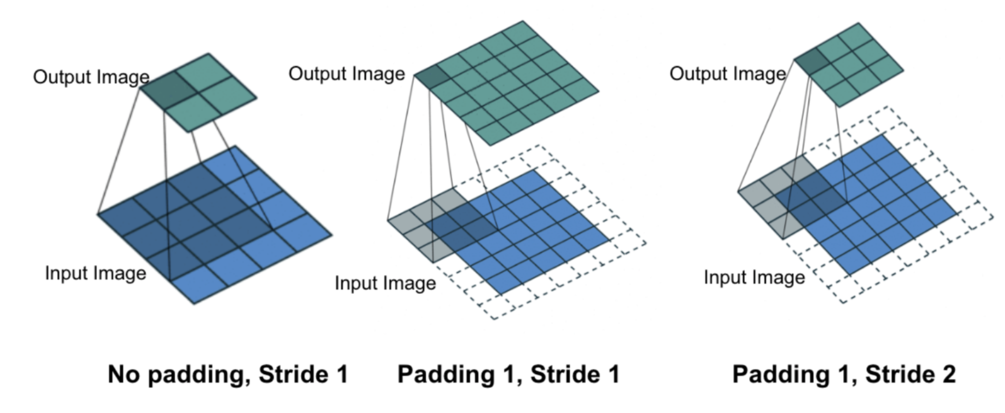
Convolutional layer
Notes:
CNNs are neural networks in which the activation functions are expressed in terms of convolutional kernels or filters
The filter is moved across the image left to right, top to bottom, with a one-pixel column change on the horizontal movements, then a one-
pixel row change on the vertical movements. The convolution for a 3×3 filter is depicted graphically in Figure 2, The three graphs show the effect of padding and stride.
Local connections: it computes local low-level
features in a small subset.
2) Shared weights: the shared nature of each filter bank allows the identification of similar
features in the overall input, which leads to a reduction in the trainable parameters.
Stride is the amount of movement between applications of the filter to the input image
Maxpooling

Slide 5
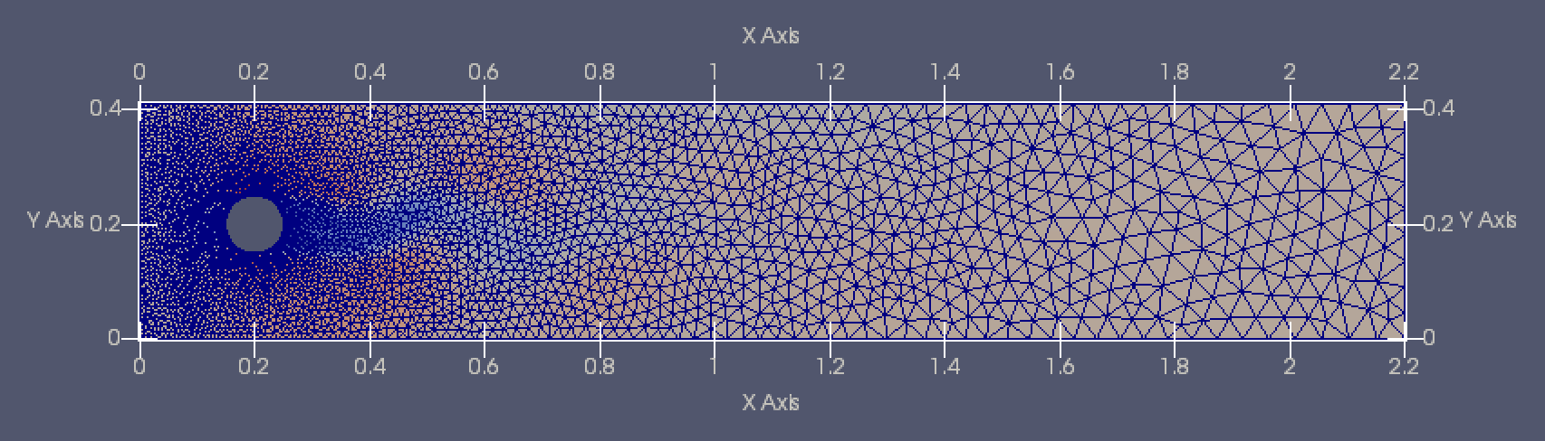
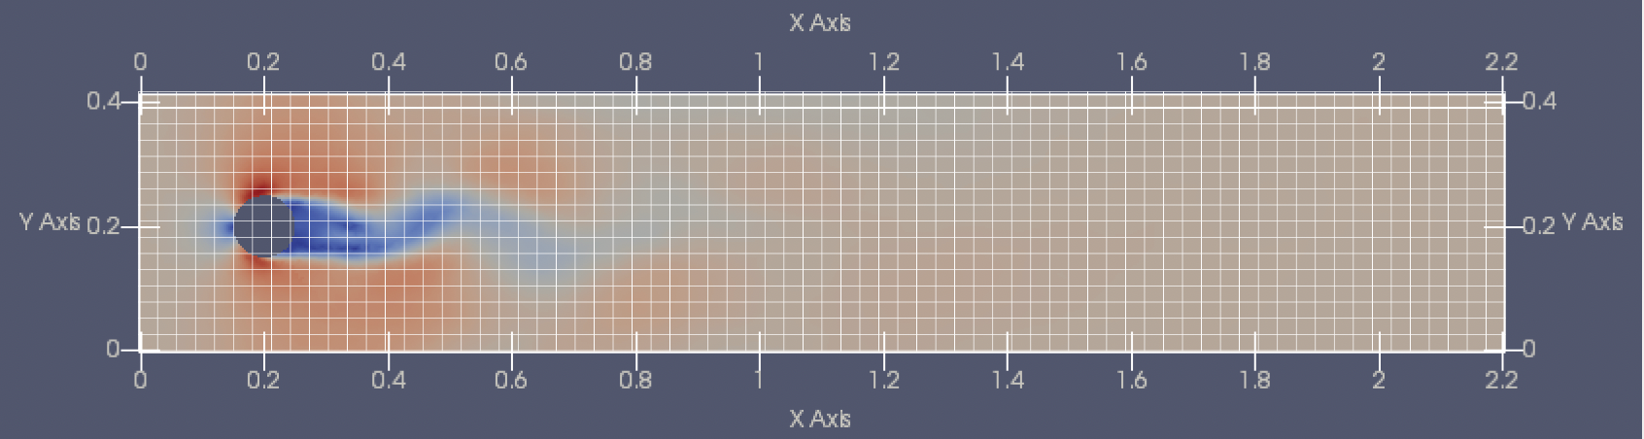
Unstructured Mesh
Notes:
The unstructured mesh is identified by irregular connectivity.
Because of this feature, Current convolutional networks cannot be applied straightforwardly to unstructured meshes.
The first challenge is how to apply
current convolutional neural networks to unstructured meshes.
The simplest approach is to interpolate the variables from an unstructured mesh to a structured mesh.
Generate a structured mesh matrix
decide the size and number of node in it.

Slide 6
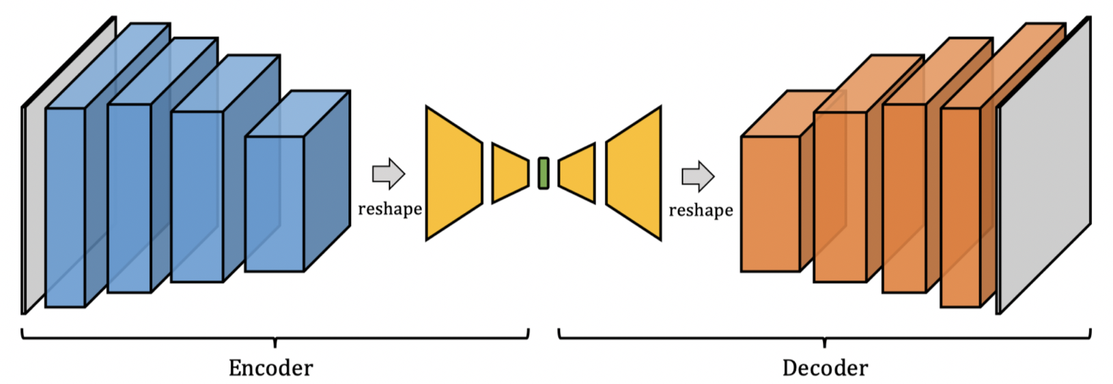
Domain Decomposition
Form subdomains containing similar resolution
Notes:
For many problems ROM is applied to, there will be areas with diﬀerent densities of nodes.
The first chanllege is how to solve the computational issue associated with the uneven density of resolution or nodes/cells in some unstructured meshes.
If we interpolate the solution variables on the unstructured mesh onto a dense uniform structured mesh, then the details in the finer parts may be lost.
If we interpolate it onto a very dense uniform strucutred mesh, then the largely over-sampled uniform mesh will result in large CPU requirements.
Domain decomposition
Different domains with different resolutions
Balance the computational efficiency and performance
Domain shape is very important in this project
what the overall aim of the approach is - that is to form subdomains containing similar resolution

Slide 7
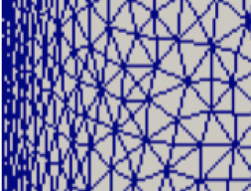
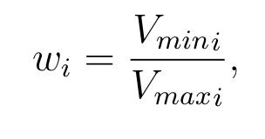
The weight of nodes
Example of a unstructured mesh
The V are the element volumes that are connected to node i
The weight indicate the boundary of dense part and sparse part
Notes:
The method has two aims, ﬁrstly to try to balance the weight sum of each sub-domain, to make them same or as similar as possible. It also minimizes the sum of the weights of nodes on the boundary between sub-domains. In other words, it reduces the communication between subdomains.
The density

Slide 8
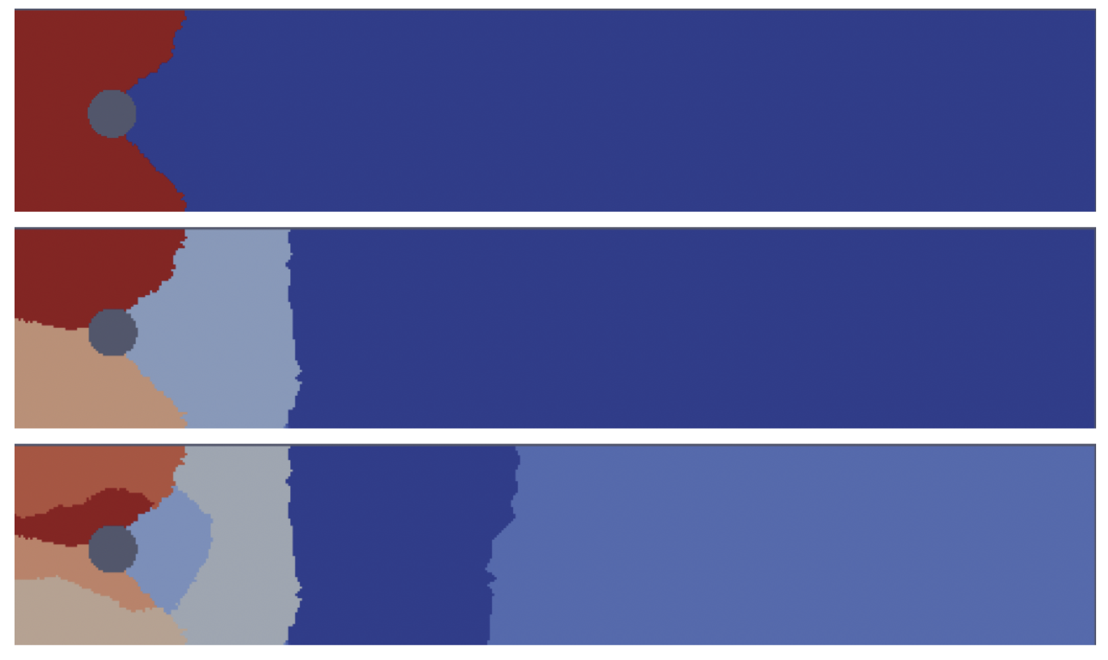
Domain Decomposition
The aims are,
balance the weight sum of each sub-domain
minimizes the sum of the weights of nodes on the boundary between sub-domains.
Example of domain decomposition when domain=2,4,8
Notes:
Boundary of domain should be boundary of sparse part and dense part

Slide 9
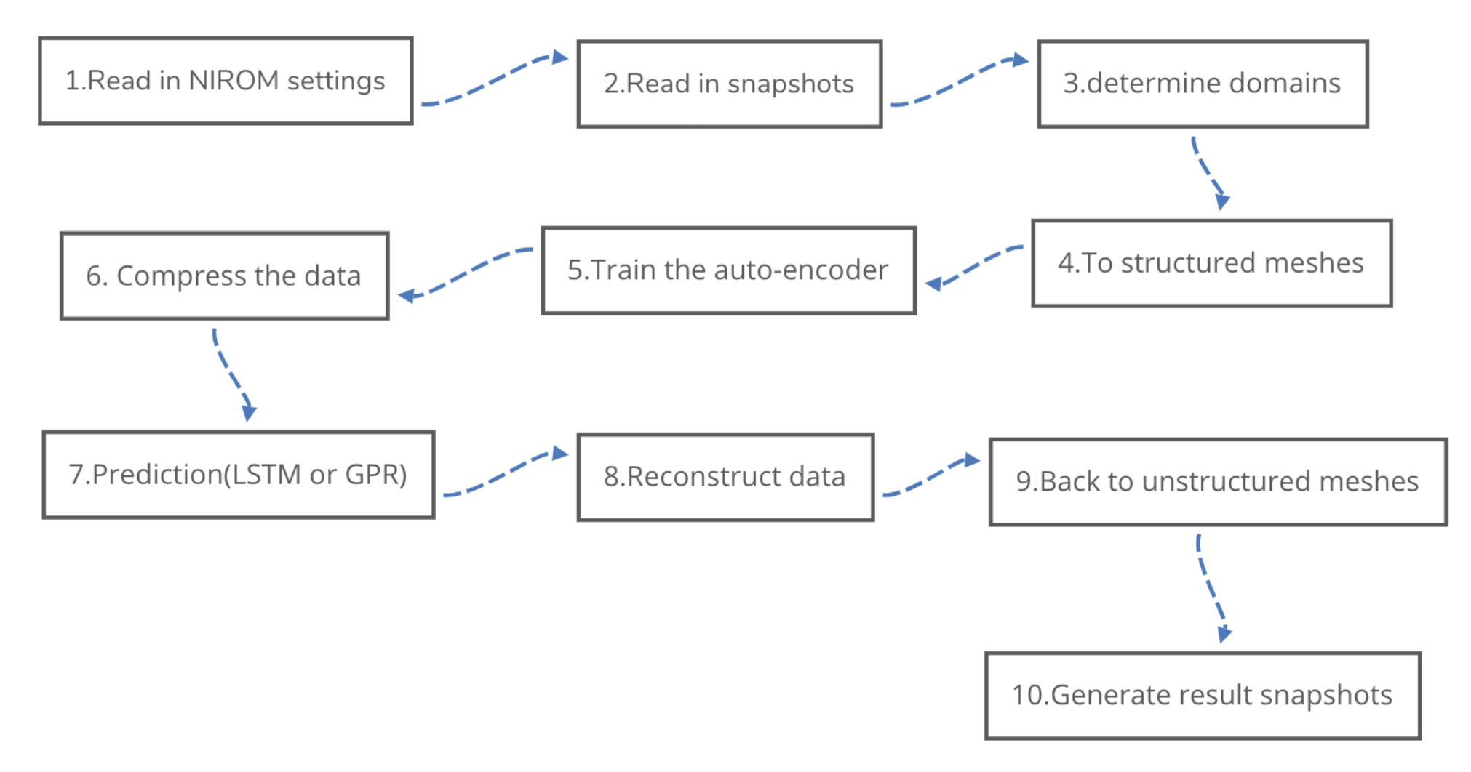
Overall process of Opal-AE
Compression
Reconstruction
Some steps can be skipped if the progress has been run before
Notes:
Snapshots for the variable of interest (e.g. velocity) are generated from the high-fidelity model (HFM). solution to the HFM taken at certain times.
Size, position, density
The third step is to train a neural network to generate hypersurfaces of the model that should have similar predictive power as the high-fidelity model. The neural network is able to map the set of POD coefficients from one-time level to the next time level, and so, predict the variables.
After a certain number of steps, the POD allows the user to reconstruct the full-dimensional state.
Some stage of this process can be skiped to speed up the progress.
If some progress has already be processed

Slide 10
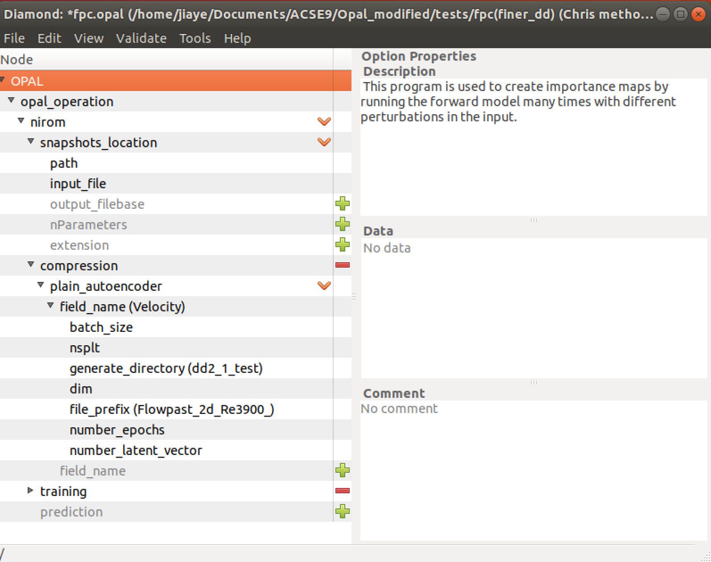
Software
System: Linux
Packages: sklearn, Keras, numpy, IC-Ferst
Main application software: Opal
New feature: Global auto-encoder(nsplt=0), DD auto-encoder(nsplt>0)
User interface including all settings
Notes:
This is developed within
the OPAL toolbox. OPAL is an open-source software written in Python, used for Reduced Order
Modeling of fluid flows and geothermal applications. It provides a set of compression and predicting
methods which are needed in order to construct Reduced Order Models (ROMs)
This work implements into OPAL (for the first time) a non-linear machine learning method for compressing fluid flow solution
variables.

Slide 11
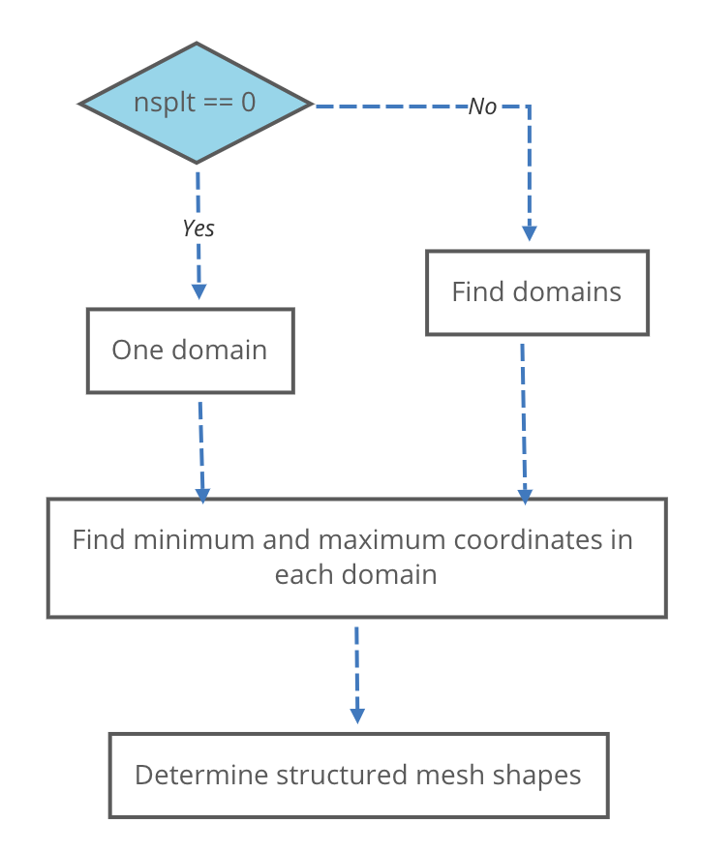
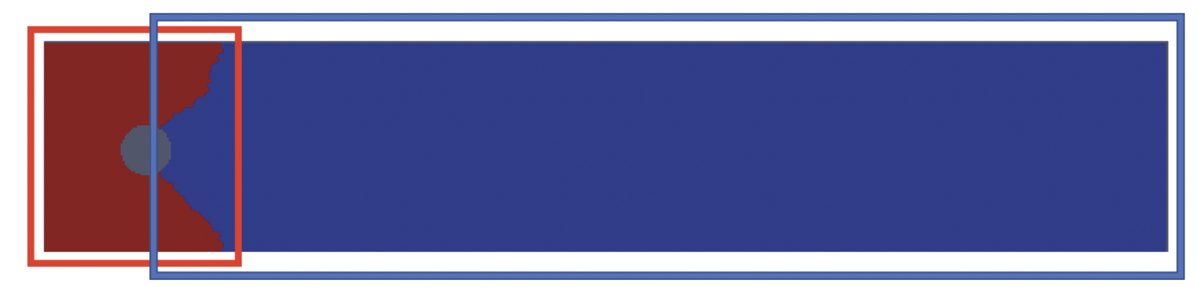
How to find mesh information
Example of domain decomposition when domain=2
Example of domain size and position when domain=2
Notes:
Give us the label that could tell us which domain the nodes is in.
Include all the nodes inside a domain.
Minimum and maximum coordinates in each domain.
Determine the boundary
Even we know the size and position of structured meshes, we still don’t know the number of nodes in them, it could be 8 by 8, 64 by 64.
To achieve the best result,
Two ways to determine mesh shapes.

Slide 12
How to determine mesh shapes
Set the length of the shortest side to 32
The length of other sides depends on shape
32
32
32
144
Find the ratio of the number of nodes in unstructured domains
Resize the product of two sides in the proportion to the ratio
64
32
64
144
Notes:
32 : 4 convolutional layers
N times of 16
Suppose the number of nodes in domains are similar.
Witchd -> The number of nodes
Number of nodes -> fraction
Make the product of two sides follow the fraction
resizes the page in proportion to the
The density is balanced

Slide 13
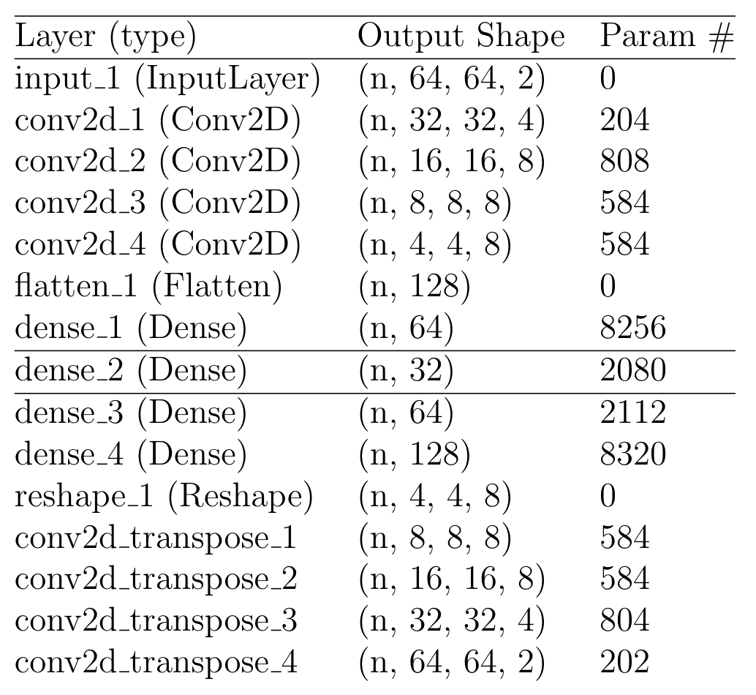
Auto-encoder
8192 -> 32 features data size is 256 times smaller
Notes:
Skip to accelerate the progress
Generate domains : generate the matrix and all the coordinates for the matrix.
3*3 filter

Slide 14
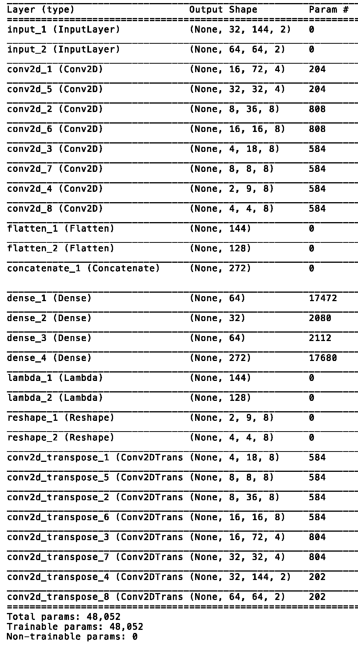
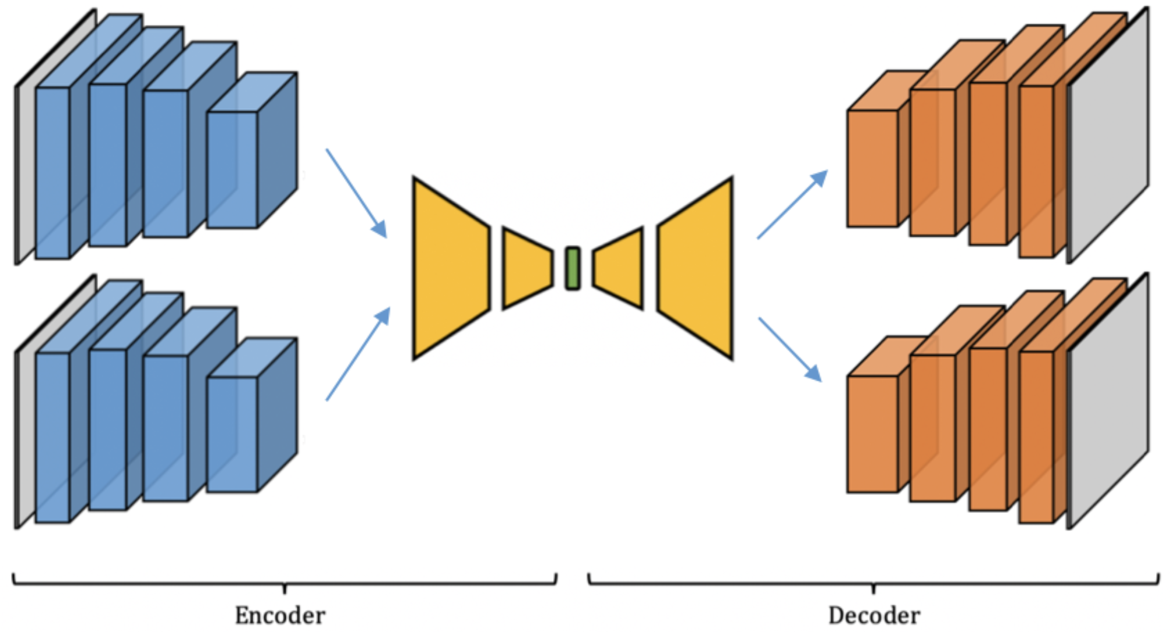
Notes:
32
We developed a general auto-encoder structure to be applied on whatever numbers of domains you want.
Just increase the number of sets of convolutional layers.

Slide 15
Results

Slide 16
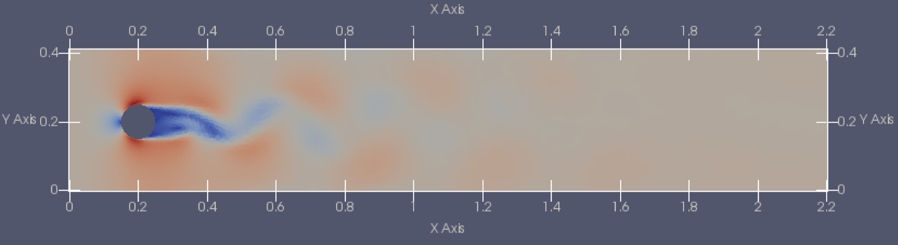
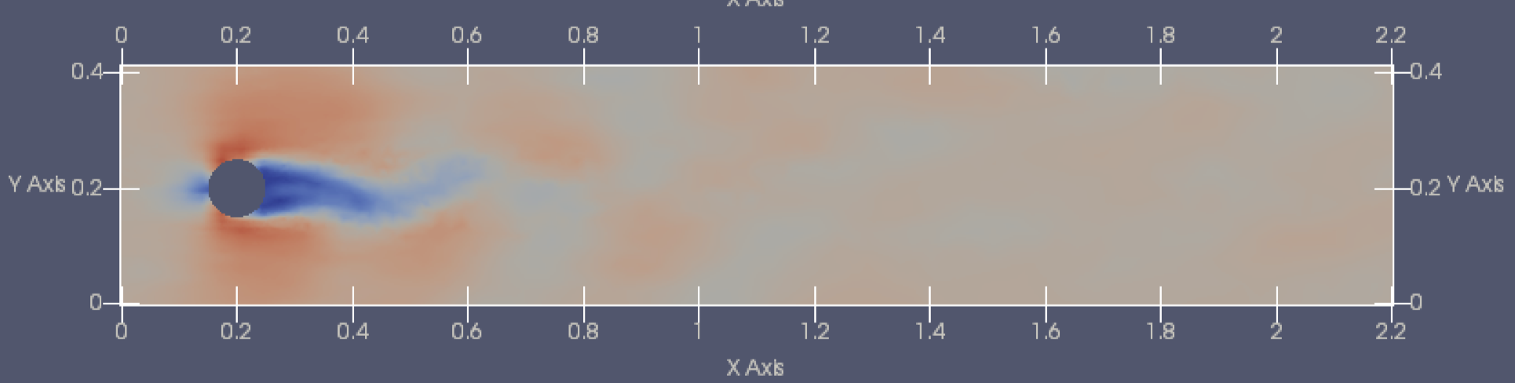
Global auto-encoder
Interpolate the whole domain to a 32*160 strucutured mesh
Using global auto-encoder to compress, 32 latent vectors
Using 2000 time steps to train the model
Pick 1/20 of the compressed data to train the GPR, and predict 100 time steps.
Training data (Original FPC data)
Prediction of 2D FPC by global auto-encoder and gaussian process regression (GPR)

Slide 17
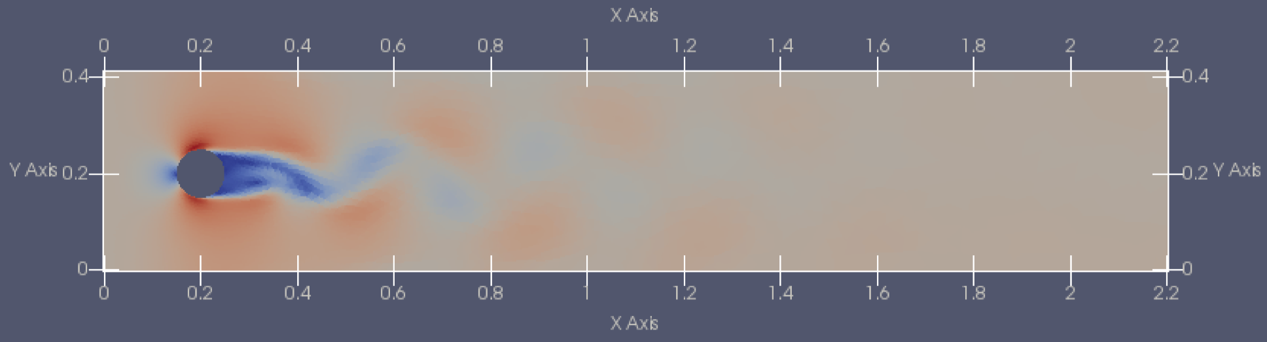
Simple Domain decomposition
Equally decompose it into 2 domains
Transform the grid into a 48×48 left structured mesh and a 32×32 right one.
Domains for simple domain decomposition
Notes:
Because the left side has more unstructured
nodes,

Slide 18
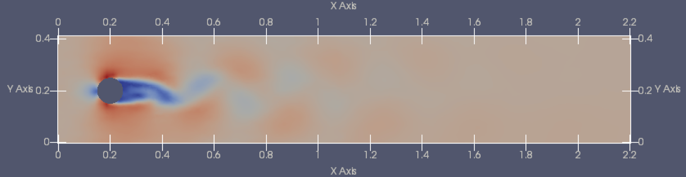
Simple Domain decomposition
Using DD auto-encoder to compress, 32 latent vectors
Using 2000 time steps to train the model
Pick 1/20 of the compressed data to train the GPR, and predict 100 time steps.
Training data (Original FPC data)
Prediction of 2D FPC by DD auto-encoder and GPR

Slide 19
Domain decomposition auto-encoder
64
32
64
144
Domains for domain decomposition, nDomain=2
80
48
64
32
48
64
64
128
Domains for domain decomposition, nDomain=4

Slide 20
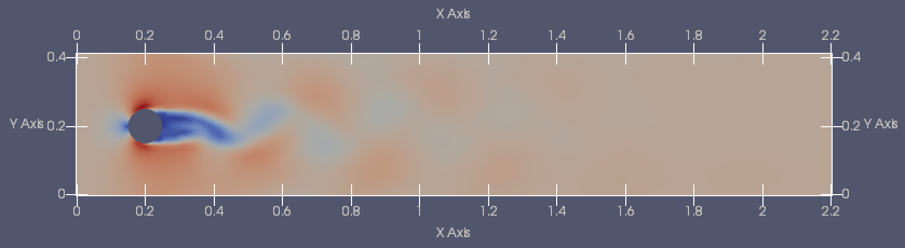
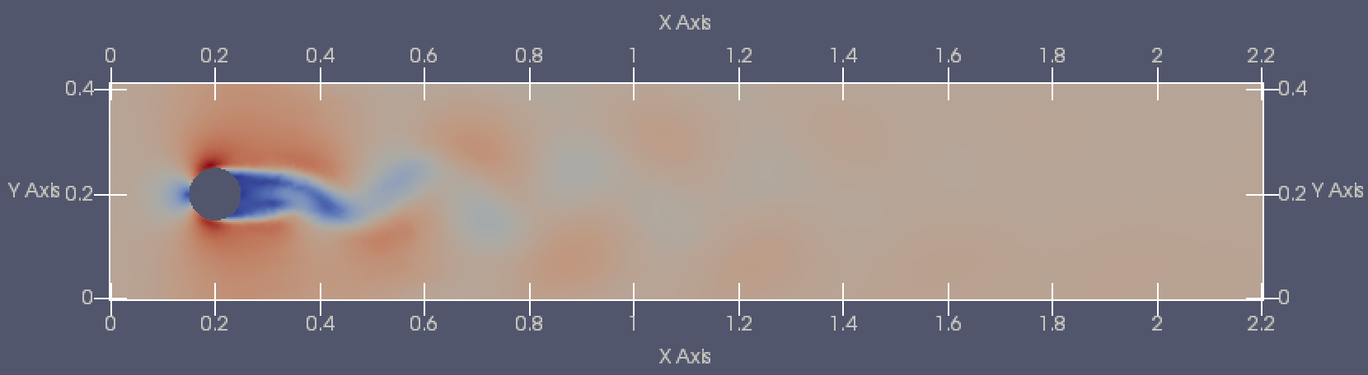
Domain decomposition
Using DD auto-encoder to compress, 32 latent vectors
Using 2000 time steps to train the model
Pick 1/20 of the compressed data to train the GPR, and predict 100 time steps.
Training data (Original FPC data)
Prediction of 2D FPC by 2-domain auto-encoder and GPR
Prediction of 2D FPC by 4-domain auto-encoder and GPR

Slide 21
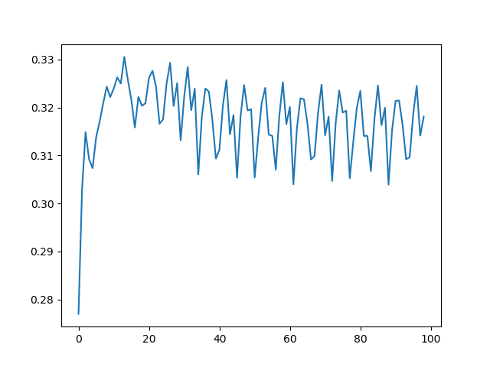
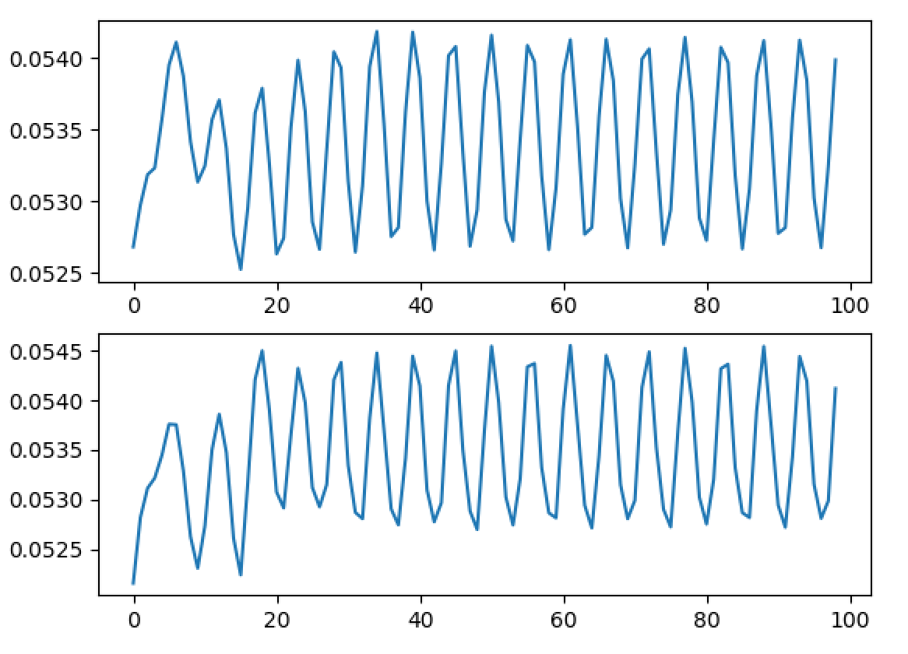
Global auto-encoder
X axis: snapshots
Y axis: norm(m/s)
Midpoint velocity (x=0.3, y=0.2)
L2 Norm
L2 Norm around 0.32

Slide 22
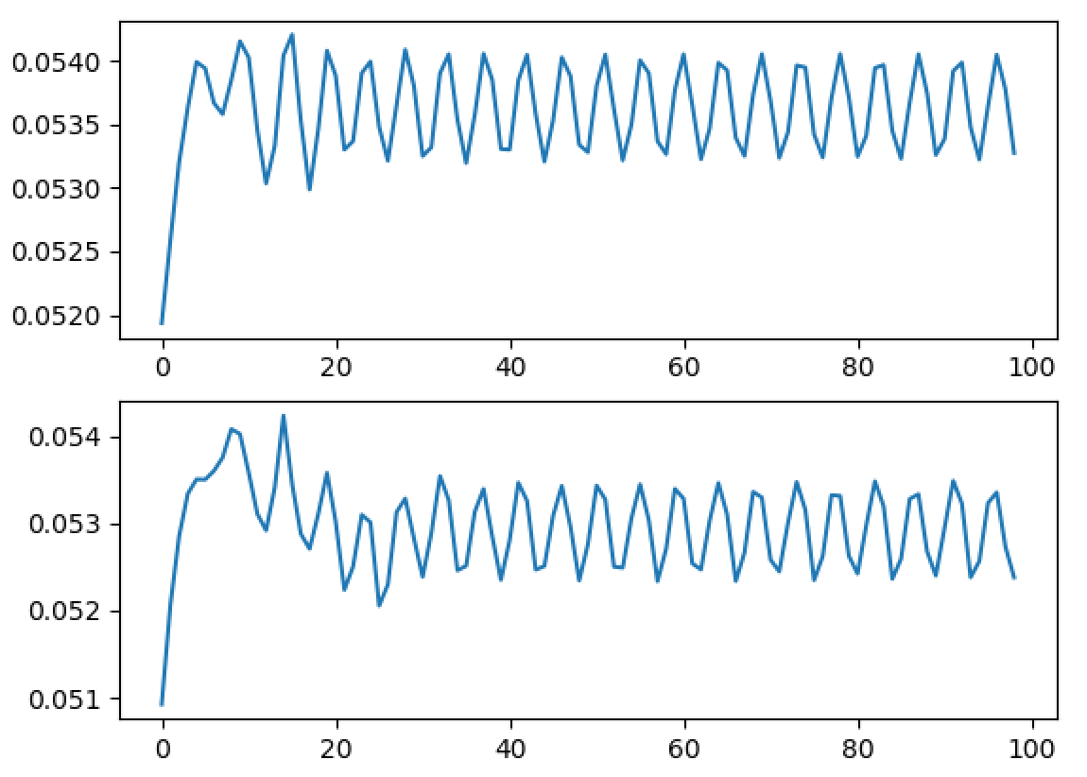
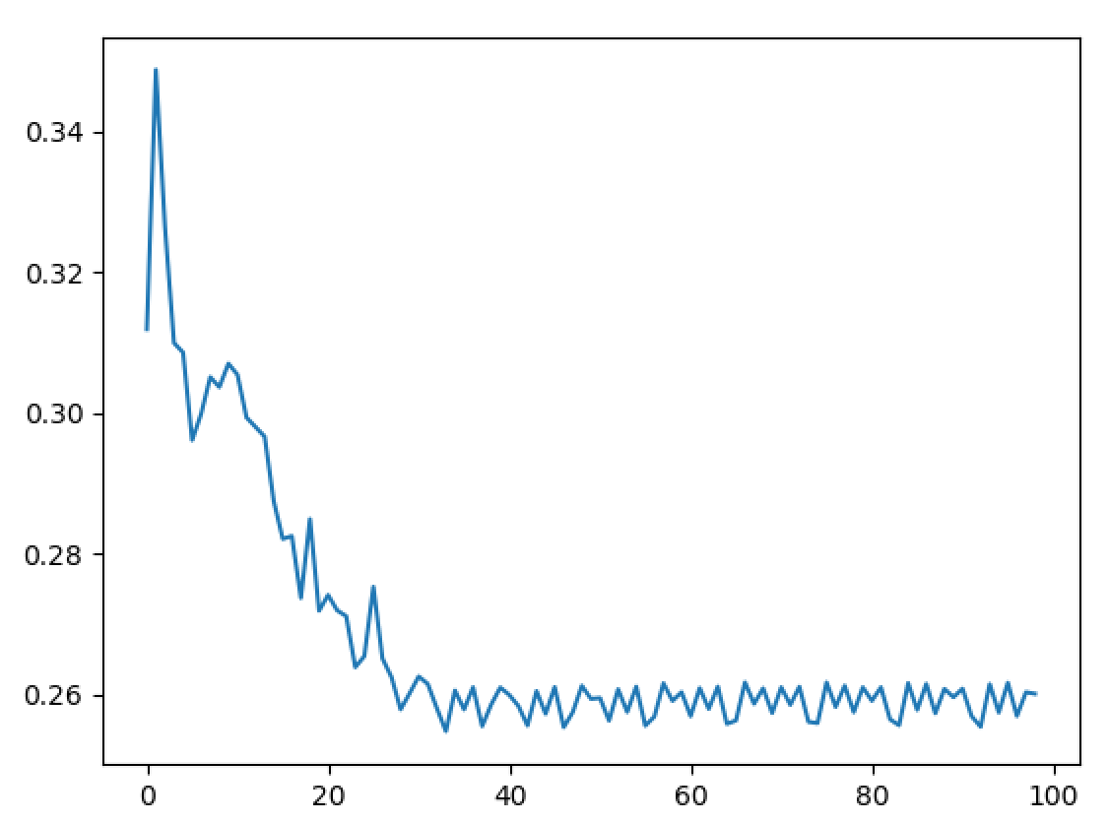
Simple Domain decomposition
X axis: snapshots
Y axis: norm(m/s)
Midpoint velocity (x axis)
Norm-2
L2 Norm around 0.26

Slide 23
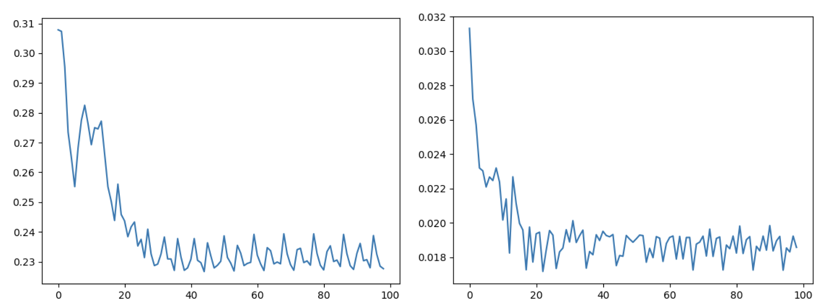
Domain decomposition(2 domains)
X axis: snapshots
Y axis: norm(m/s)
X axis: snapshots
Y axis: norm(m/s)
0.23
Norm-2 and Norm-max
for 2 domains

Slide 24
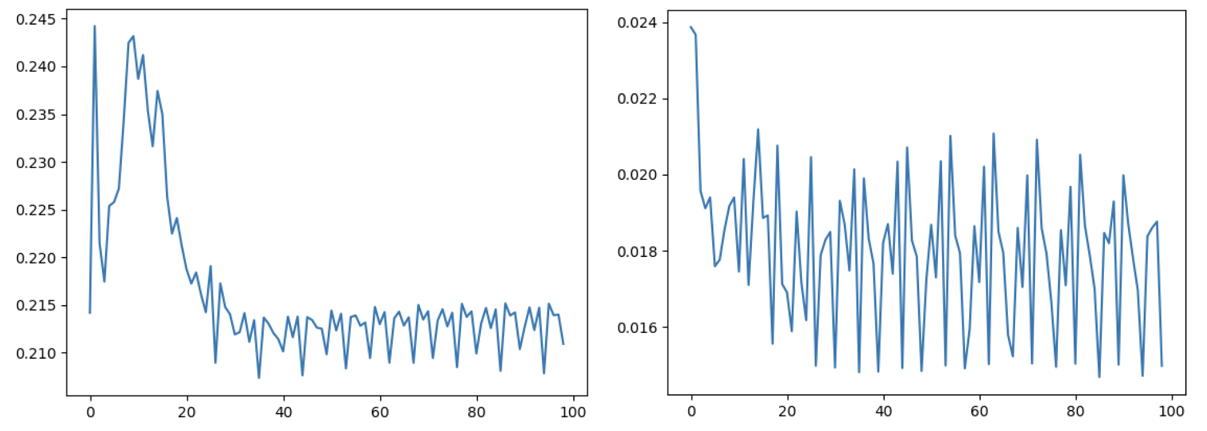
Domain decomposition(4 domains)
X axis: snapshots
Y axis: norm(m/s)
X axis: snapshots
Y axis: norm(m/s)
0.21
Norm-2 and Norm-max
for 4 domains

Slide 25
Conclusion
Implemented the transformation between unstructured mesh and structured mesh using linear interpolation
Implemented domain decomposition version of the convolutional auto-encoder
Implemented the algorithm to determine the domain shape that could balance the number of nodes in domains
Effectiveness of auto-encoder in compression is promissing
Notes:
In this paper, we have presented the new Opal-AE, Python-based, flexible, and powerful NIROM compression method that provides a suite of settings for compression of flow and other solution variables.
We interpolate the solution variables from an unstructured finite element mesh to a structured mesh in order to use a convolutional auto-encoder designed for imaging.
We also implemented a domain decomposition version of the convolutional auto-encoder so that it may be efficiently applied to unstructured meshes with vastly different mesh resolutions.
We have proved the effectiveness of the auto-encoder with flow past a cylinder test cases. The results show that the domain decomposition convolutional autoencoder method is a promising approach for compression on unstructured meshes. As the number of subdomains increases the results become more accurate.

Slide 26
Q & A

Slide 27
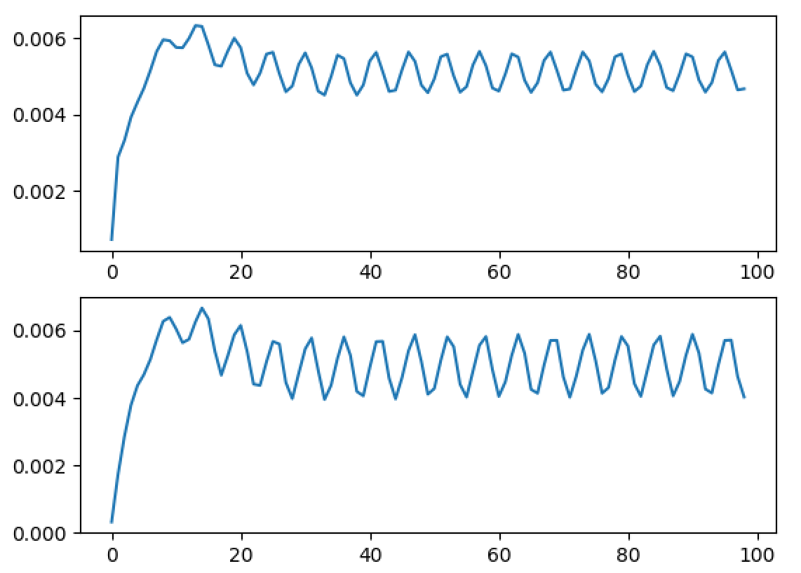
Global auto-encoder
Midpoint veloctiy (x axis)
Midpoint velocity (y axis)

Slide 28
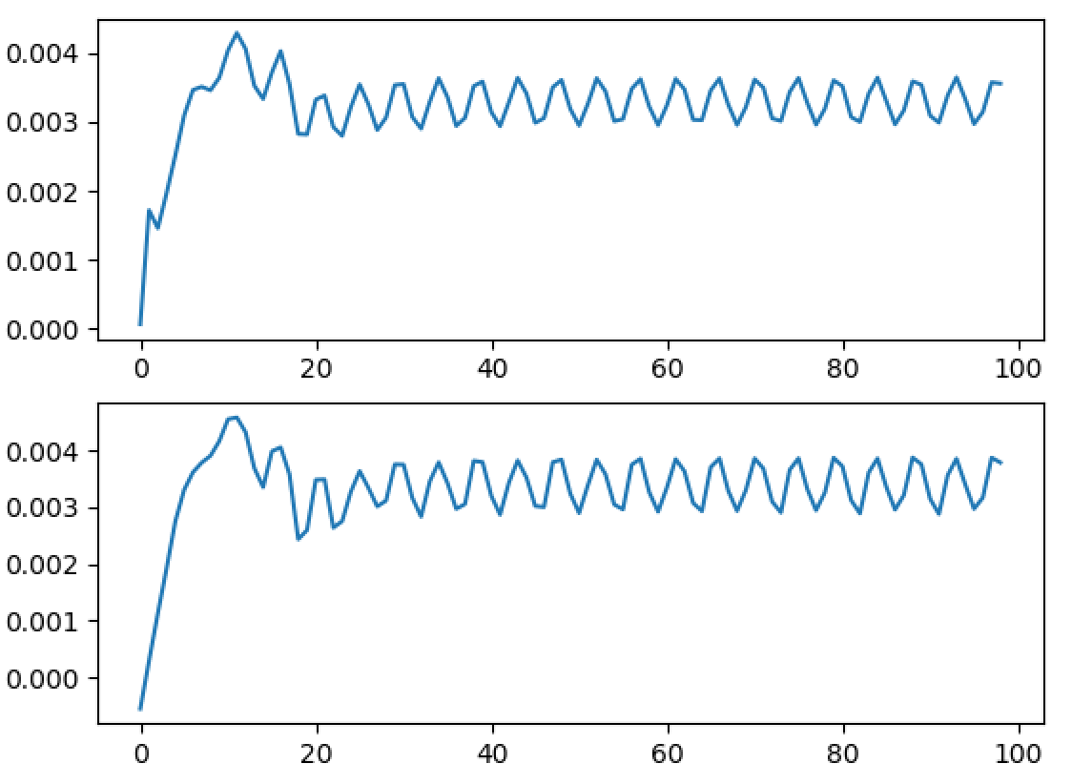
DD auto-encoder
Midpoint veloctiy (x axis)
Midpoint velocity (y axis)

